Slide 1
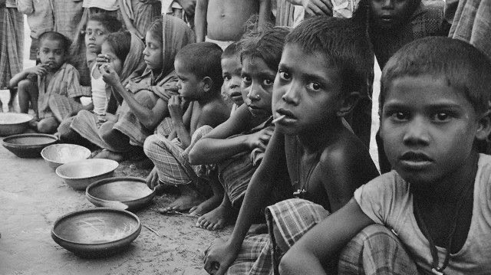
DTI
DESIGN THINKING AND INNOVATION
This is Pradeep

Slide 2
Zero hunger
EVALUATION
IDEAS
Implement blockchain technology to track the journey of food products from the source to the consumer. This can enhance transparency, traceability, and food safety.
Create an app that allows users to plan their meals for the week, generate shopping lists based on selected recipes, and track the nutritional content of their meals.
Develop a platform that connects individuals, local businesses, and food banks to share surplus food. Users can post available food items, and those in need can request or pick up the items.
Create an online platform that offers courses and resources on sustainable and eco-friendly cooking practices. This can include tips on reducing food waste, choosing locally sourced ingredients, and adopting plant-based diets.
Create a system for restaurants to manage their food inventory efficiently. This includes features for real-time tracking, automated reordering, and waste monitoring.
Blockchain ensures data integrity, reduces the risk of fraud, and enables consumers to make informed choices about the origin and quality of the food they consume.
This app can promote healthier eating habits, efficient grocery shopping, and reduce the likelihood of impulse purchases. It also aids in managing dietary preferences and restrictions.
This idea can help minimize food waste, support the community, and provide assistance to those facing food insecurity. Proper logistics and safety measures should be in place.
Such platforms can contribute to a more sustainable food ecosystem by educating individuals on the environmental impact of their food choices and providing practical solutions.
Such a system can help restaurants optimize their supply chain, reduce costs, and maintain consistent quality. It also contributes to sustainability by minimizing food wastage.

Slide 3
IDEAS
10 GRAMS IDEAS
IDEA ONE : Support Local Farmers or Markets
IDEA TWO: Make Sustainable Food Choices
IDEA THREE: Donate to Charities
IDEA FOUR: Buy Local and In-Season Food
IDEA FIVE: Grow Some of Your Own Food
IDEAE SIX: Break the Cycle of Conflict and Hunger
100 GRAMES IDEAS
IDEA ONE: Developing a Food App / Website Donation.
IDEA TWO: Increase Sustainability and Build Resilience to Climate Change
IDEA THREE: Installing Refrigerators to Store Food.
IDEA FOUR: Help Rural Farmers Connect to Markets.
IDEA FIVE :Reduce Food Waste & Food Loss.
IDEA SIX: Collecting left over food and Donating to poor people.

Slide 4
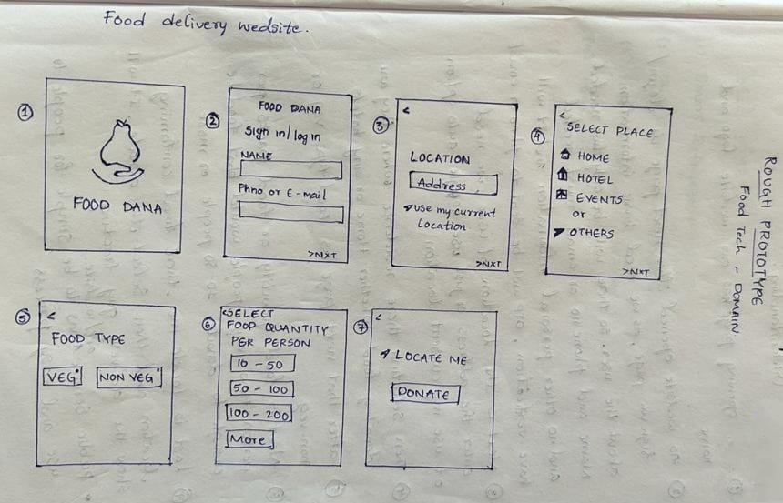

Slide 5
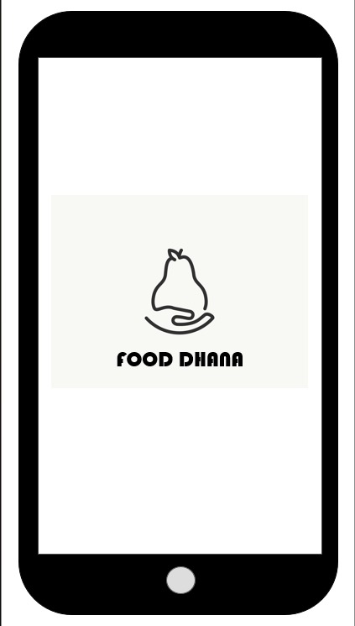
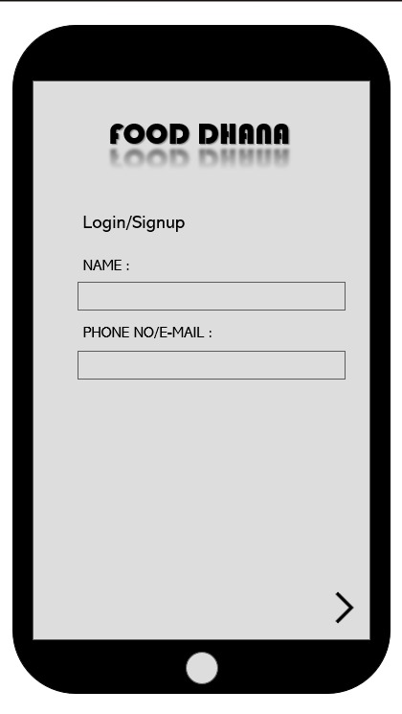
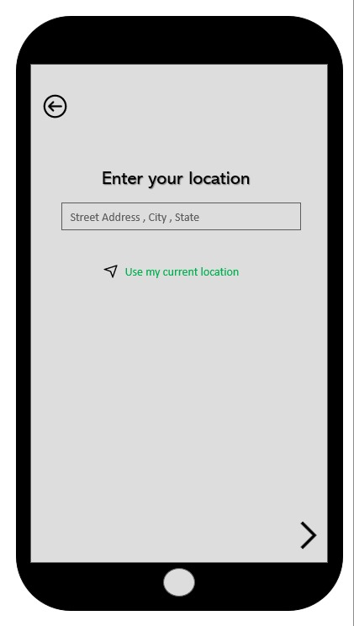
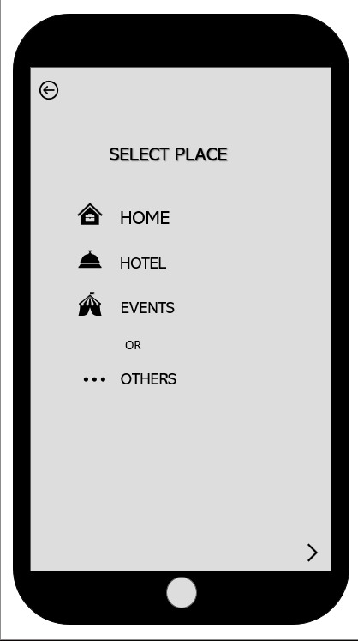
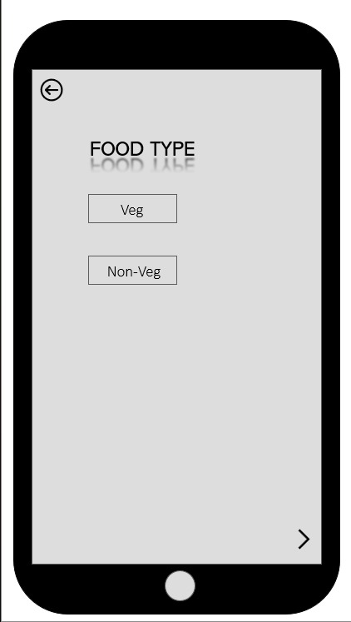
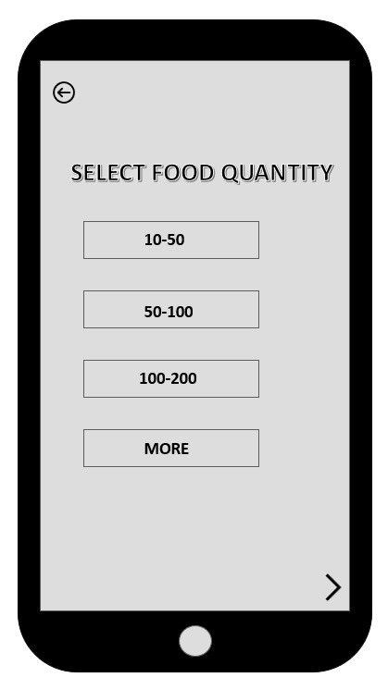
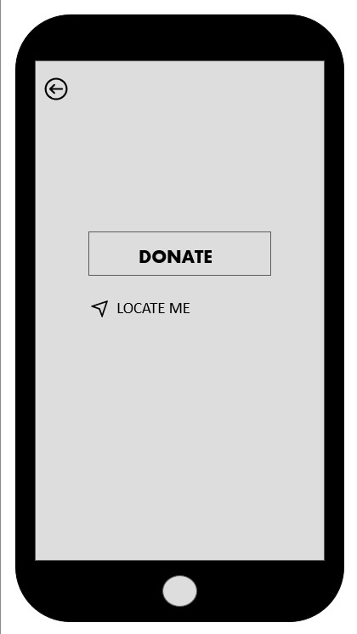

Slide 6
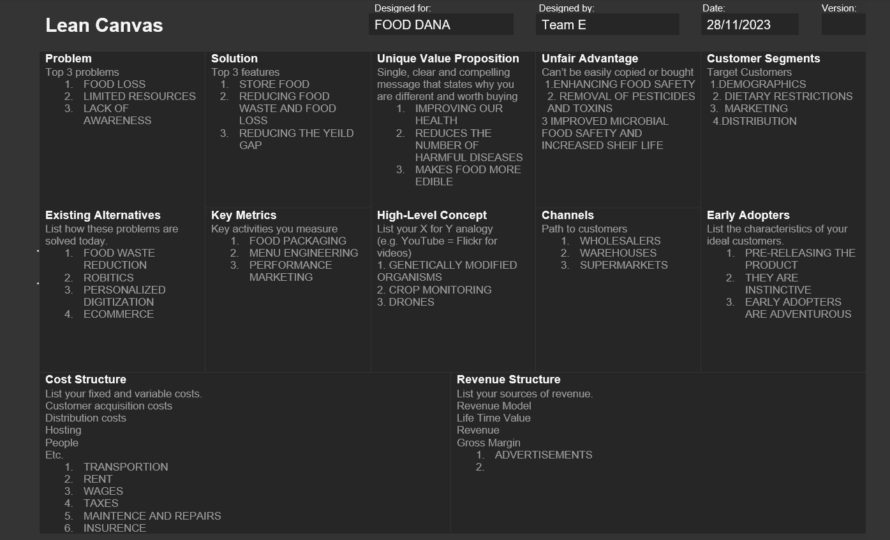
L
E
A
N
CAVA
S

Slide 7
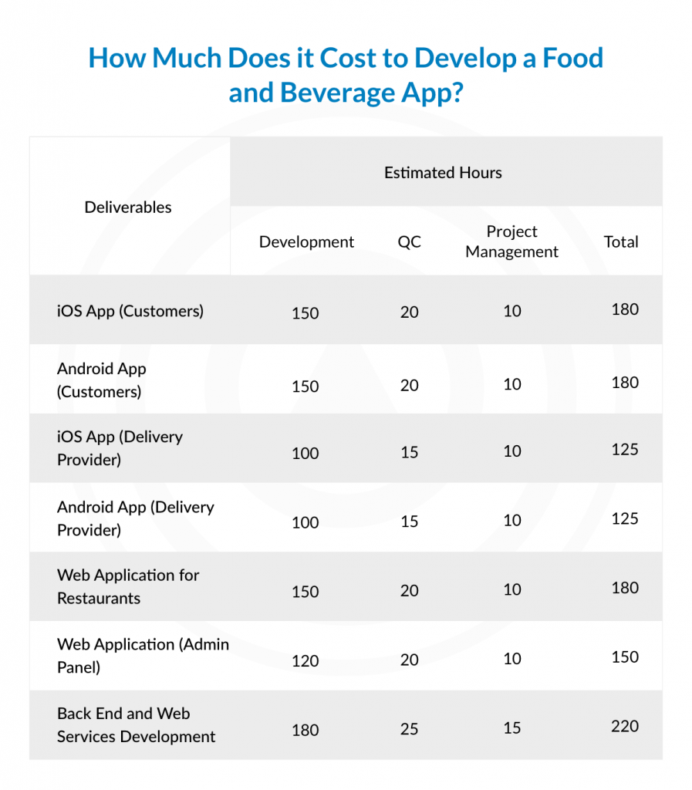
1. Create a Brand Identity.
2. Increase Activity & Visibility on Social Media.
3. Create a Website For Your Food Delivery Service.
4. Improve Quality of Service
5. Sign Up With Major Food Directories.
6. Participate in Food Festivals & Local Events.
7. Sponsor a Charity Or a Local Cause.

Slide 8
